Slide 1
FINAL PRESENTATION
Leveraging Deep Learning to Estimate the Damage Caused by Natural Disasters
Summer 2023
Course: CSE499B
Section - 11

Slide 2




Supervisor
Our Team
Dr. Shahnewaz Siddique
Md. Rifat Ahmed
Saifur Rahman Rubayet
Gazi Shoaib

Slide 3
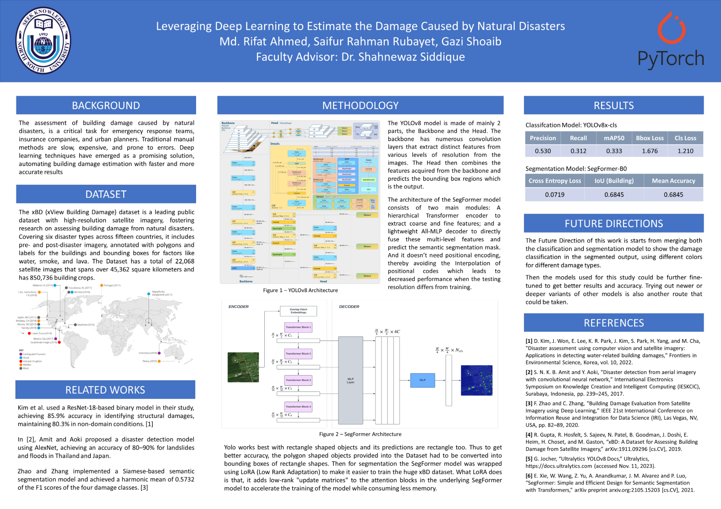

Slide 4
01
BACKGROUND

Slide 5
Background
Assessing post-disaster building damage is critical for emergency response, insurance, and urban planning.
Traditional methods are slow, costly, and error-prone.
Our project employs deep learning, automating damage estimation for faster and more accurate results.

Slide 6
Objectives
The primary objective of our project was to develop a deep learning-based system for building damage estimation.
We aimed to create a robust and efficient solution that can accurately analyze images of damaged buildings.
A project that can provide a reliable assessment of the extent and severity of the damage.

Slide 7
Motivation
Saving Lives
Mitigating Damage
Emergency Preparedness
Informing Policy and Planning
Resource Allocation

Slide 8
-Dr.Katharine Hayhoe
Quote
“Knowing the storm is coming empowers us to fortify our foundations and seek higher ground. Prediction is not just a scientific pursuit; it is a lifeline for humanity”

Slide 9
02
RELATED
WORKS

Slide 10
Related Works
Kim et al. used a ResNet-18-based binary model in their study, achieving 85.9% accuracy in identifying structural damages, maintaining 80.3% in non-domain conditions. [1]
In [2], Amit and Aoki proposed a disaster detection model using AlexNet, achieving an accuracy of 80–90% for landslides and floods in Thailand and Japan.
Zhao and Zhang implemented a Siamese-based semantic segmentation model and achieved a harmonic mean of 0.5732 of the F1 scores of the four damage classes. [3]

Slide 11
03
DATASET

Slide 12
About the Dataset
The xBD (xView Building Damage) dataset is one of the largest and highest quality public datasets of annotated high-resolution satellite imagery.
It was created to advance the research and development of methods for assessing building damages caused by natural disasters, such as earthquakes, floods, and wildfires.
Includes pre- and post-disaster imagery for six different types of disaster and fifteen countries.
The dataset contains bounding boxes and labels for environmental factors such as water, smoke, and lava. [4]

Slide 13
Disaster Types in the Dataset
Hurricane
Earthquake
Flood
Volcano
Tsunami
Wildfire

Slide 14
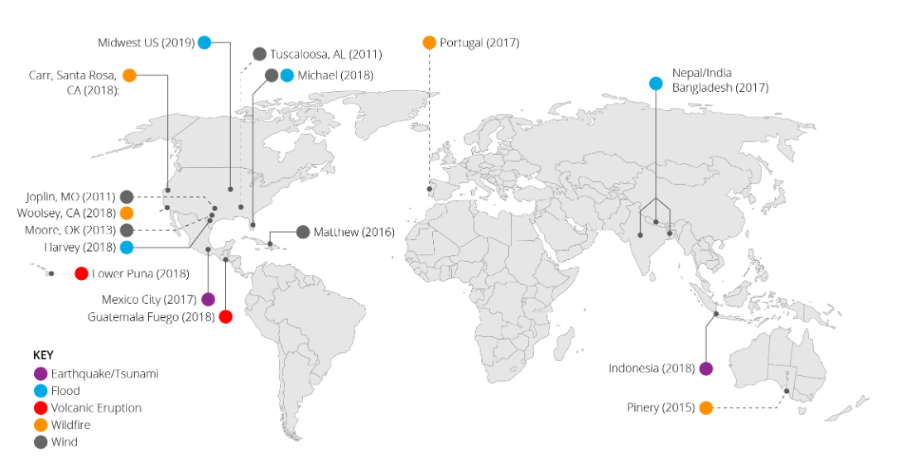
About the Dataset
22,068
22,068
850,736
45,362
Total Images
Total Buildings
Total Images
Square Kilometer Images

Slide 15
Methodology
04

Slide 16
Classification Model 1
ARCHITECTURE
LOSS FUNCTIONS
1
2
YOLOv8
BBox Loss &
Cls Loss
LEARNING RATE
OPTIMIZER
3
4
Adam Optimizer
150 Epochs at a Rate of 0.001

Slide 17
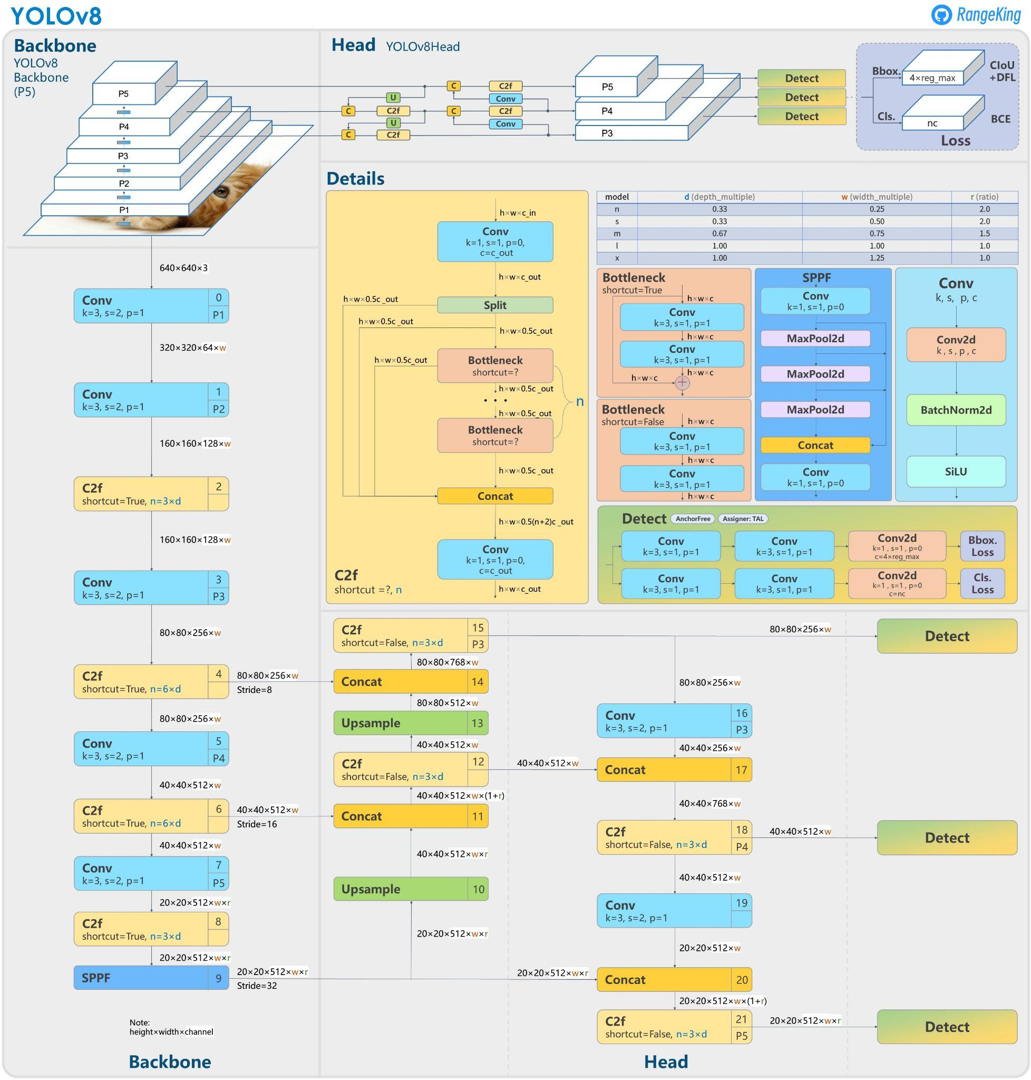
YOLOv8 Architecture
Versatile, so suitable for various applications and easily adaptable to various hardware platforms
Pre-trained on the ImageNet-1000 & COCO 2017 Dataset
Variety of Models for Detection, Segmentation, Classification & Pose Estimation
Supports a full range of vision AI tasks

Slide 18
Classification Model 2
ARCHITECTURE
LOSS FUNCTION
1
2
ResNet-50
Cross Entropy
LEARNING RATE
OPTIMIZER
3
4
Adam Optimizer
150 Epochs at a Rate of 0.001

Slide 19
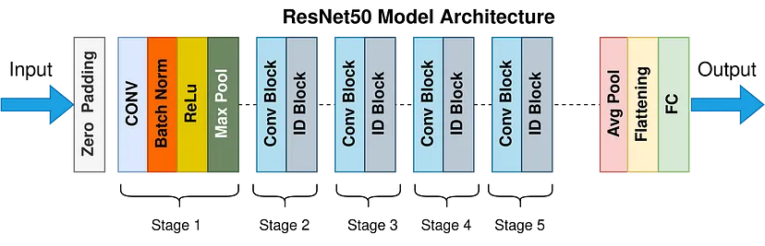
ResNet-50 Architecture
Architecture with 50 deep layers
Pre-trained using the ImageNet-1000 Dataset
Has a Predefined Input Size of 224 x 224 x 3
Solves the Problem of “Vanishing Gradient”

Slide 20
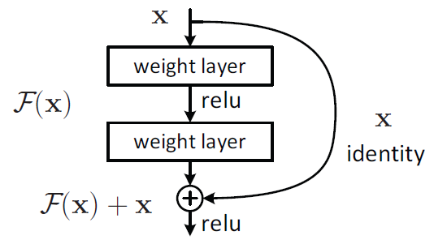
Residual Block
Residual Blocks are stacked together to form the ResNet architecture
Residual Blocks are Shortcut Connection blocks that deals with the “Vanishing Gradient” issue
Residual Block: A building Block

Slide 21
Segmentation Model 1
ARCHITECTURE
LOSS FUNCTIONS
SegFormer
(wrapped in LoRA)
1
2
Cross Entropy Loss
LEARNING RATE
OPTIMIZER
3
4
Adam Optimizer
15 Epochs at a Rate of 0.001

Slide 22
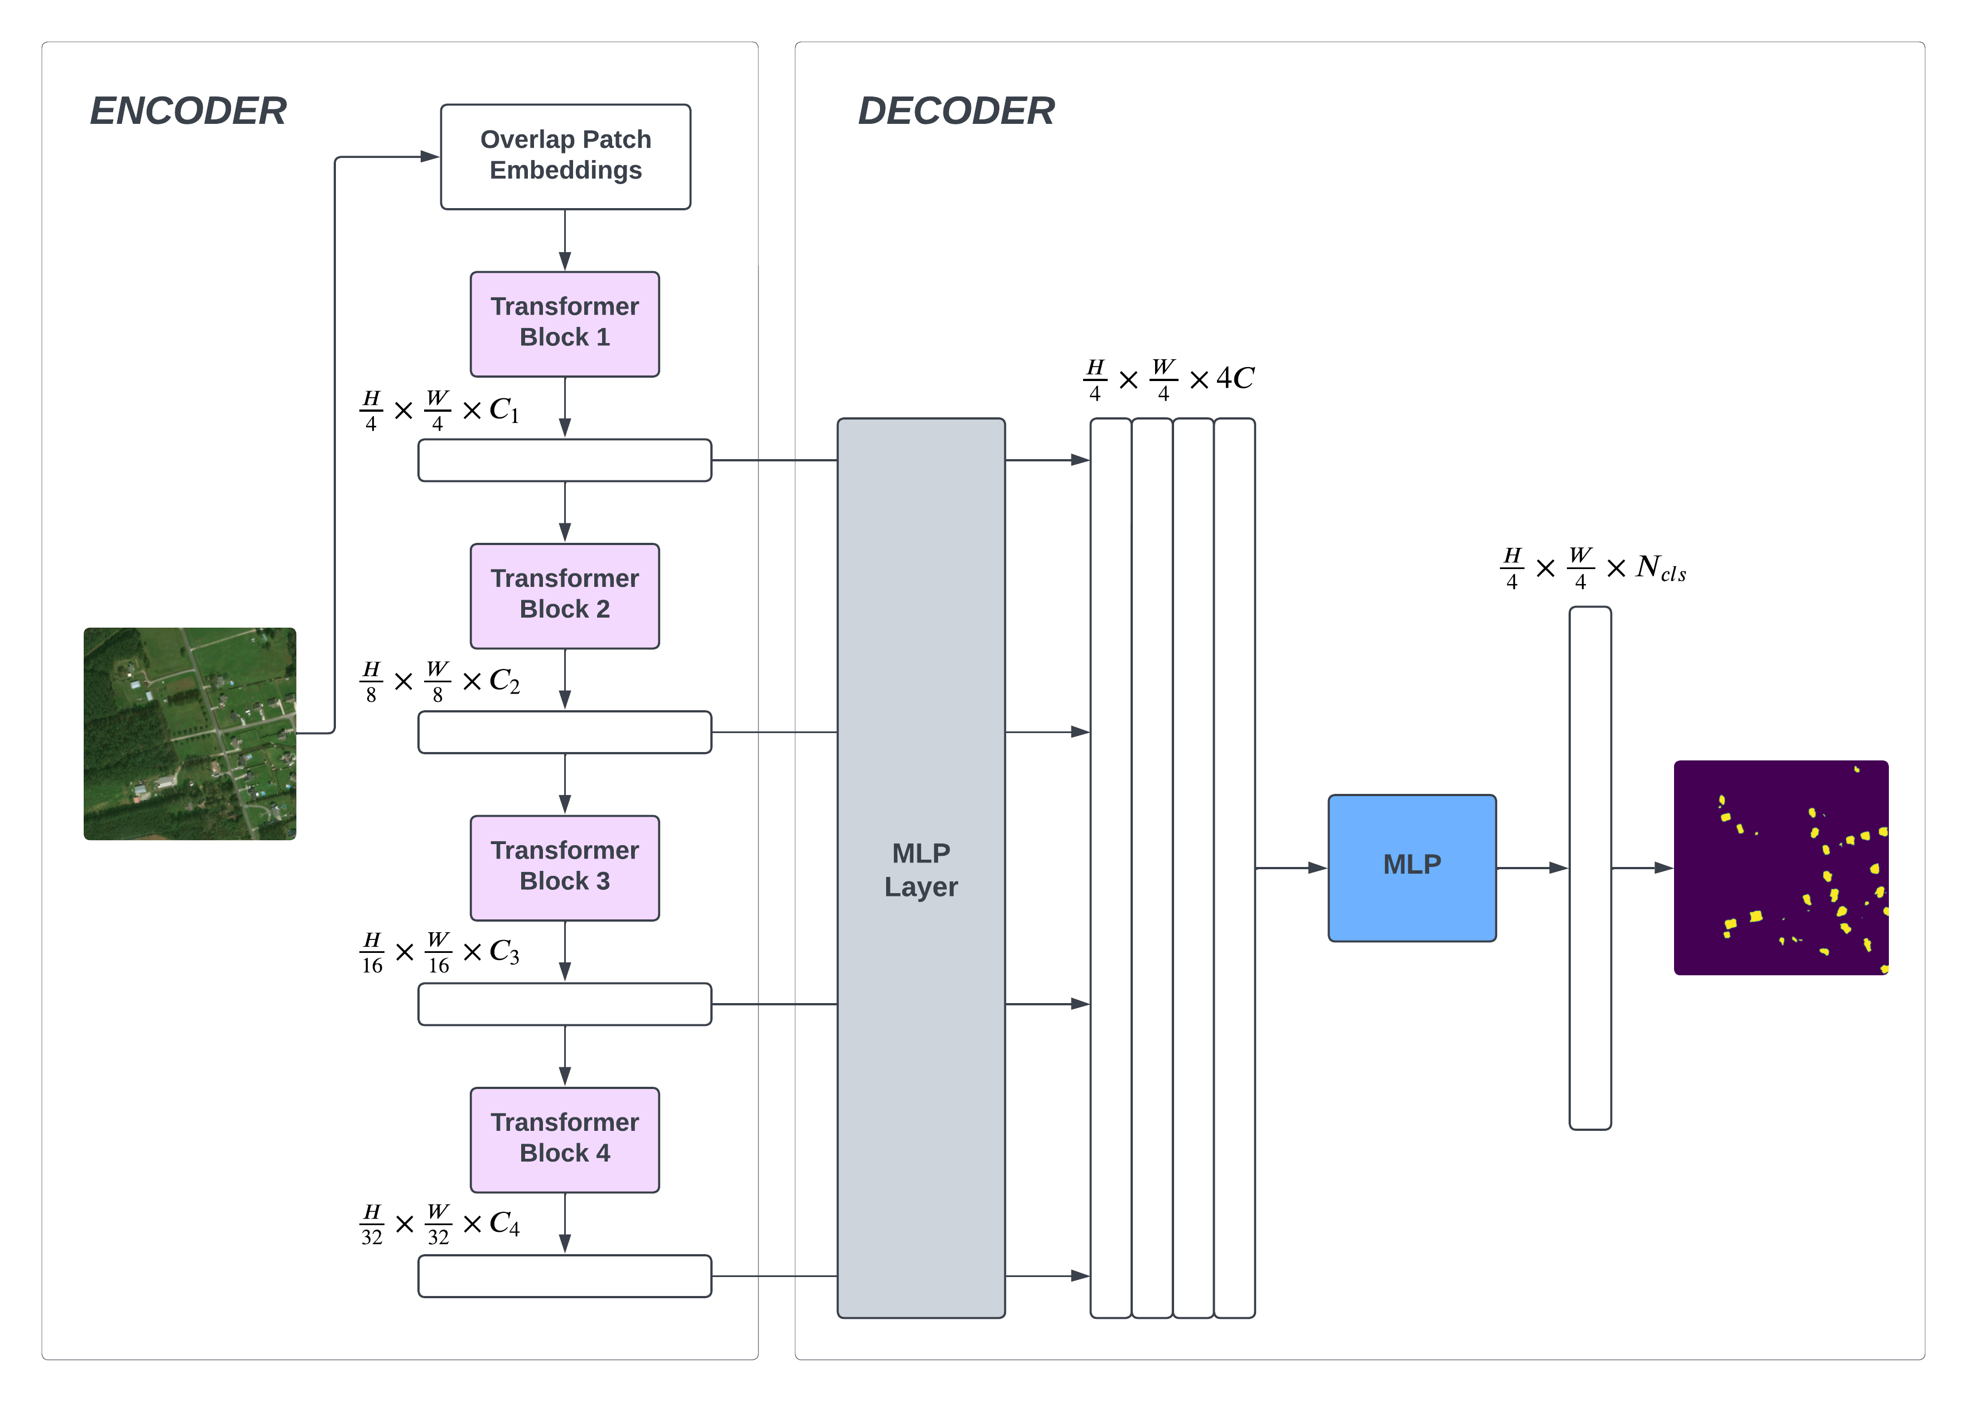
SegFormer Architecture
Inspired from Transformer Model
Consists of Hierarchical Transformer Encoder, and a lightweight all-MLP Decoder
Doesn’t depend on positional encodings like Vision Transformers
3.7M Parameters in the Smallest model

Slide 23
Segmentation Model 2
ARCHITECTURE
LOSS FUNCTIONS
YOLOv8
1
2
BBox Loss &
Cls Loss
LEARNING RATE
OPTIMIZER
3
4
Adam Optimizer
15 Epochs at a Rate of 0.001

Slide 24
Implementation
YOLO works best with Rectangle shaped objects but the dataset has Polygon labels making it more complex
So converted the polygons into bounding boxes of Rectangle shape to get better accuracy using the YOLOv8 model
Wrapped the SegFormer model using LoRA (Low Rank Adaptation) to train the segmentation model faster since the size of the xBD Dataset is huge
Merged the YOLO classification model with the SegFormer segmentation model to show Segmented Damage Classified Output

Slide 25
05
RESULTS

Slide 26
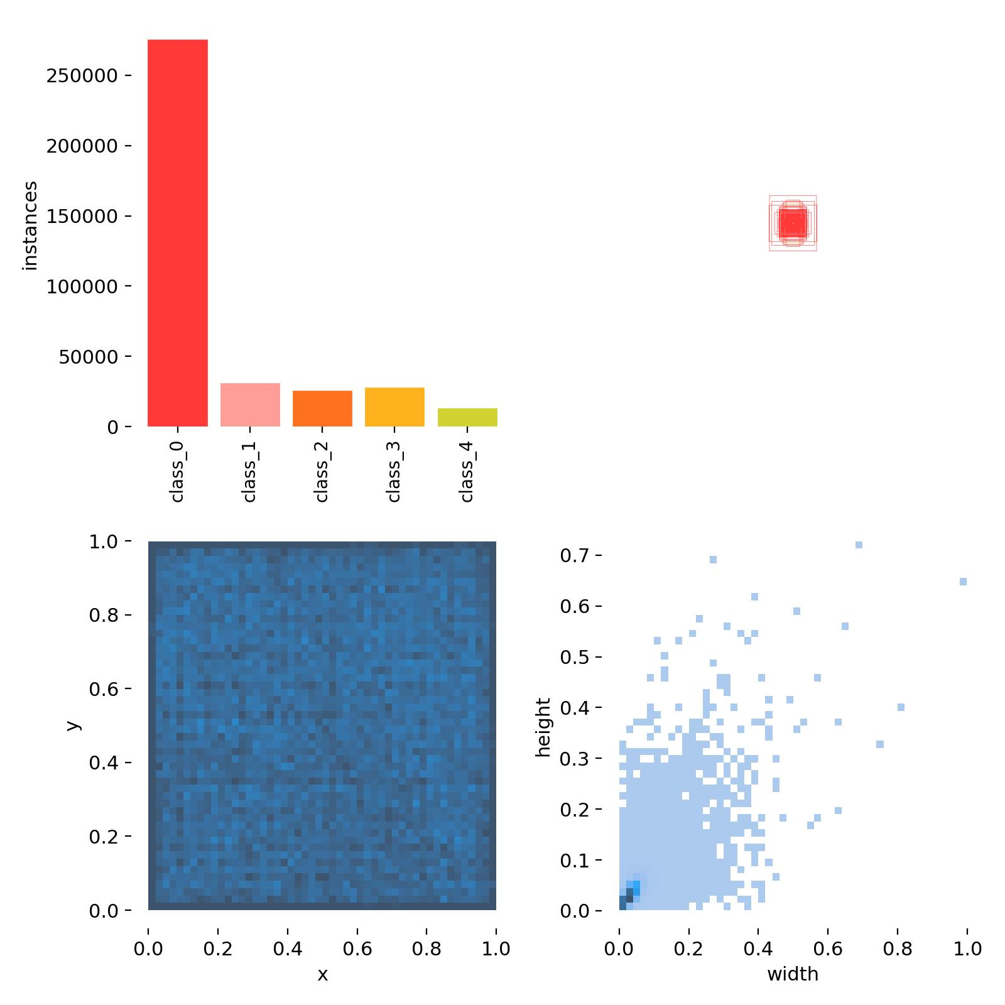
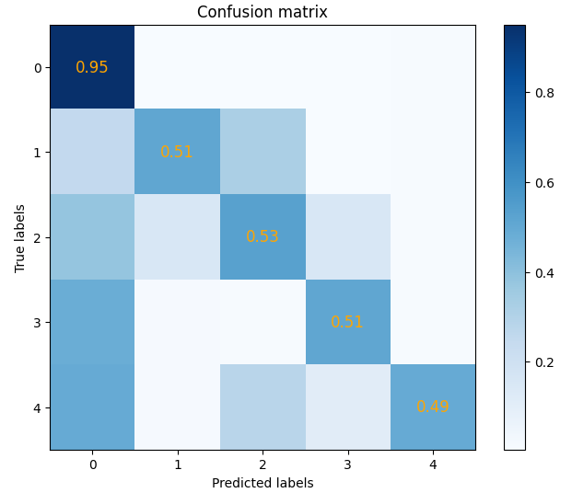
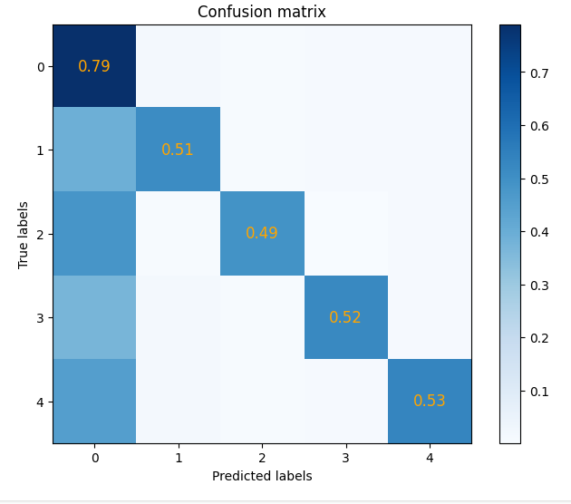
Confusion Matrix (Classification)
ResNet-50
YOLOv8x

Slide 27
Classification Model 1
MODEL: YOLOv8x-cls
Precision | Recall | mAP50 | BBox Loss | Cls Loss
0.530 | 0.312 | 0.333 | 1.676 | 1.210

Slide 28
Classification Model 2
MODEL: ResNet-50
Precision | Recall | Mean Accuracy | Cross Entropy Loss
0.598 | 0.518 | 52.53% | 1.126

Slide 29
Segmentation Model 1
MODEL: SegFormer-B0 (wrapped using LoRA)
Cross Entropy Loss | IoU (Building) | Mean Accuracy
0.0719 | 0.6845 | 68.45%

Slide 30
Segmentation Model 2
MODEL: YOLOv8n-seg
Precision | Recall | Accuracy | BBox Loss | Cls Loss
0.342 | 0.215 | 0.486 | 2.012 | 2.477

Slide 31
06
FUTURE
DIRECTIONS

Slide 32
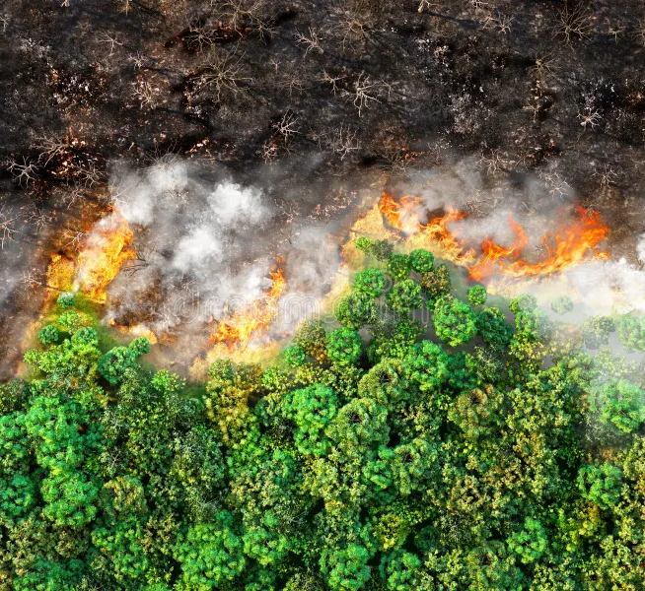
MODEL MODIFICATIONS
Use Larger YOLO and SegFormer models for Segmentation
Fine tune our models even further
Use Data Augmentation
Try out newer or deeper variants of other models

Slide 33

WEB APP
We can deploy the work using a Web App

Slide 34
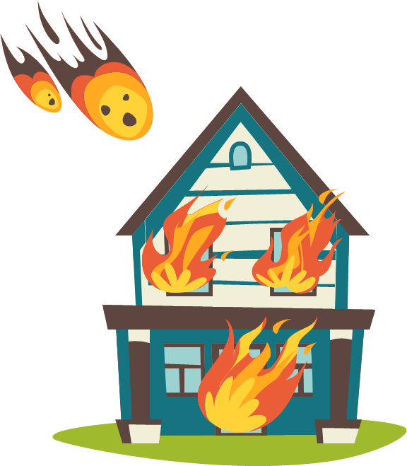
07
CONCLUSION

Slide 35
Conclusion
Our comprehensive approach to building damage classification employed advanced models tailored to specific tasks
We used YOLOv8 and ResNet-50 for classification and saw that YOLOv8 was giving more accurate results
For semantic segmentation, the SegFormer model, exhibited a decent accuracy that can be improved using larger model while YOLOv8 also generated a closer result in Segmentation that can be fine tuned further
These models form a powerful toolkit for building damage assessment

Slide 36
REFERENCES
08

Slide 37
REFERENCES
1
D. Kim, J. Won, E. Lee, K. R. Park, J. Kim, S. Park, H. Yang, and M. Cha, "Disaster assessment using computer vision and satellite imagery: Applications in detecting water-related building damages," Frontiers in Environmental Science, Korea, vol. 10, 2022
2
S. N. K. B. Amit and Y. Aoki, "Disaster detection from aerial imagery with convolutional neural network," International Electronics Symposium on Knowledge Creation and Intelligent Computing (IESKCIC), Surabaya, Indonesia, pp. 239–245, 2017
3
F. Zhao and C. Zhang, "Building Damage Evaluation from Satellite Imagery using Deep Learning," IEEE 21st International Conference on Information Reuse and Integration for Data Science (IRI), Las Vegas, NV, USA, pp. 82–89, 2020

Slide 38
REFERENCES
4
R. Gupta, R. Hosfelt, S. Sajeev, N. Patel, B. Goodman, J. Doshi, E. Heim, H. Choset, and M. Gaston, “xBD: A Dataset for Assessing Building Damage from Satellite Imagery,” arXiv:1911.09296 [cs.CV], 2019
5
G. Jocher, “Ultralytics YOLOv8 Docs,” Ultralytics, https://docs.ultralytics.com (accessed Nov. 11, 2023)
6
K. He, X. Zhang, S. Ren, and J. Sun, "Deep residual learning for image recognition," Proceedings of the IEEE conference on computer vision and pattern recognition, pp. 770-778. 2016

Slide 39
REFERENCES
7
“Residual Neural Network - an overview | ScienceDirect Topics,” ScienceDirect, https://www.sciencedirect.com/topics/computer-science/residual-network (accessed Jun. 6, 2023)
8
E. Xie, W. Wang, Z. Yu, A. Anandkumar, J. M. Alvarez and P. Luo, “SegFormer: Simple and Efficient Design for Semantic Segmentation with Transformers,” arXiv preprint arxiv.org:2105.15203 [cs.CV], 2021

Slide 40
THANKS!

